Slide 1
Competency Based Training (CBT&A Methodology) Trainer & Assessor(Level 4)
Day-5 Session-1
Apply OSH Practice in CBT&A Environment
DR. Sheikh Abu Reza
Director (Rtd) DTE &
CBT&A Trainer

Slide 2
Apply OSH Practice in CBT&A Environment
Identify OSH issues in relating to work environment
Control and report OSH issues
Conduct work safely
Follow emergency response procedure
Maintain and improve health and safety in work places
P-6

Slide 3
3.1 OSH issues in work environment
OSH Law in Bangladesh :
Occupational Health and Safety has been discussed a lot in the context of major accident held in Bangladesh RMG industry in 2013. Most of the times, OHS has been suggested as CSR contribution. However it is widely understood that OHS interventions have certain business case. Business cases are the motivation but the laws are requirements. The Bangladesh Labour Law 2006 (amendment 2013) has certain OHS provisions which are legal requirements for the Bangladesh industries to comply. Bangladeshi textile and clothing manufacturing companies must comply with those laws. This article summarizes the OHS laws in Bangladesh.
P- 13

Slide 4
The Four Steps to Hazard Identification
Identify by inspection or use of Hazard Identification report
Assess by use of Risk Assessment matrix
Eliminate or control –complete Risk Assessment summary report
Review-complete Risk Assessment summary report

Slide 5
Most common safety groups
Health and Safety representatives
Supervisors
OSH Officers
Health and Safety committees
P - 14

Slide 6
Duties of OSH Officer
Organise OSH training
Investigate accidents
Provide first aid
Undertake risk assessment at the work place
P - 14

Slide 7
OSH Standards
Identify the Hazard
Clear the area close to Hazard
Partition the Hazard area and protect all from them
Clear the Hazard
P - 16

Slide 8
3.2 Control and report OSH issues
Hazards and incidents are reported to appropriate personnel according to procedure.
This step may include:
Reporting the issue verbally to your supervisor or manager
Reporting the issue through the workplace’s hazard reporting
Raising the issue with the health and safety representative
Raising the issue with management through safety officer
P - 20

Slide 9

What is a Hazard?
A source of potential harm to people or a situation with potential to cause injury or loss to plant, property or equipment
Anything or anyone that can harm or cause ill health to a person,
Anything or anyone that can damage property or the environment,
A combination of these things.

Slide 10
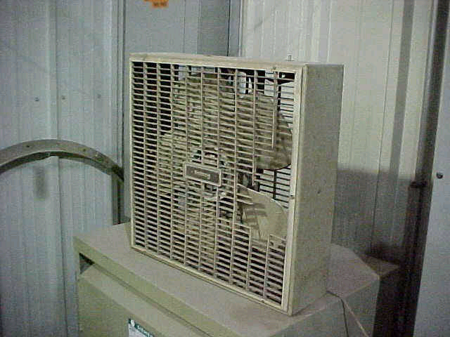
Types of Hazards
Physical Hazards
Biological Hazards
Chemical Hazards
Ergonomic Hazards

Slide 11
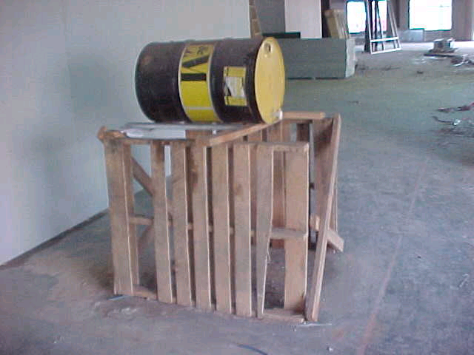
Physical Hazards
Examples:
floors, slippery surfaces, stairs, steps, ladders,
fire,
falling objects,
manual handling (lifting, pushing pulling etc.),
noise, vibration,
poor lighting, ventilation, or air quality

Slide 12
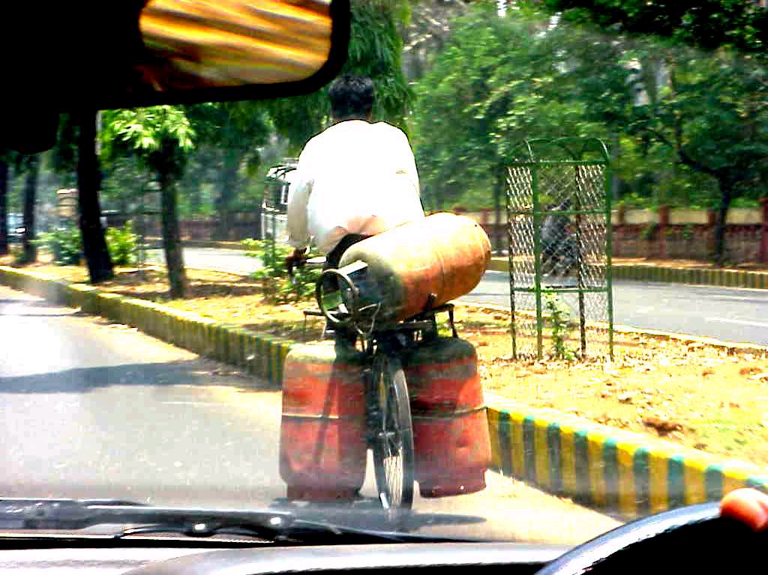
Chemical Hazards
Examples:
chemical substances,
dangerous goods
cleaning agents,
dusts and fumes,
acids or poisons
explosives

Slide 13
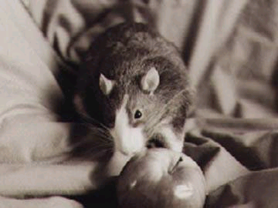
Biological Hazards
Examples:
radiation
microbiological
viruses
insects
vermin
animals

Slide 14

Ergonomic Hazards
Work related musculoskeletal
Disorders develop when the same muscles
Are used over and over again, usually while applying force, and with little recovery time Away from the task.
They also develop when Workers have to maintain a fixed position while working.
Effect
Cause injury to muscles, bones, Blood vessels, tendons, nerves and Other soft tissues
Strain injuries such as carpal tunnel Or tennis elbow
Tendonitis
Repetitive sprain or strain injury
Prolonged strain results in pain and
Injury, which may cause impairment
And disability

Slide 15
Hazard Management
Spot the Hazard
Assess the Hazard
Fixed the Hazards
Evaluate the result

Slide 16
Steps for Hazard Control
Hazard identification
Hazard inventory
Hazard ranking
Assessing provability of occurrence
Hazard rank assessment
Hazard elimination/reduction/control
P - 30

Slide 17
Group Activity
See the NAPO video and identify the steps and hazards NAPO faced
Note down on the blank sheet

Slide 18
3.3-1 Conduct Work Safely
Minimum standards on safety and health in the workplace
Appropriate seat, lighting and ventilation
Adequate passageways and exits and firefighting equipment's
Separate toilet facilities for man and woman
Appropriate protecting clothing like protective gear, masks, helmets, safety boots, coats, goggles etc.
First aid kits
Free medical and dental services
P _ 36

Slide 19
Issues of young worker
There is so many reasons for getting heart of young worker
Not enough training
Not enough experience
Don’t know there legal right
Afraid to ask questions
Tired from trying to balance work with school and other activities
P _ 36

Slide 20
Cost of injury
Family and friends
Employer
Co-workers
Community
P _ 36

Slide 21
Responsibilities under osh
Duties of Employers
Establish a health & safety policy and program
Provide required training
Provide the information, instruction and supervision you need to do your job safely
Make sure you have necessary safety equipment
Provide information on hazards in the workplace
Important information's are
The health & safety policy
The OSH act
P _ 36

Slide 22
Responsibilities under osh
Duties of Supervisor
Make sure that you follow the law and the companies safety rules
Tell you about any job hazards or dangers
Make sure you use safety equipment properly
Role of Employees
Obey the law and the companies safety rules
Use machine and equipment safely
Report hazards to your Supervisor or Manager
Ware required PPE
Work safely and don’t fool around
P _ 36

Slide 23
Responsibilities under osh
Your Rights
The right to know
The right to practice
The right to refuse
General Training
Companies health and safety
Companies safety rules
Emergency procedures
How to get first aid
Work safely and don’t fool around
Specific Training
How to do your job safety
How to deal with hazards materials
How to use PPE
How to operate machinery safely
P _ 36

Slide 24
3.3-2 Personal Protective equipment's
PPE
Appropriate seat lighting and ventilation
P _ 36

Slide 25
3.4-2 proper use of fire extinguisher
Steps using portable fire extinguisher
Pull the pin of the fire extinguisher
Aim the nozzle at the bottom of the fire
Squeeze the handle of the fire extinguisher
Sweep or side to side motion
P _ 59

Slide 26
3.5-1maintain and improve health & safety
Frame for the process in OSH
Identify Hazards
Assessing associated risks
Taking action to medicate the risks
Monitoring the effectiveness
P _ 59

Slide 27
Sources for hazard identification
Frame for the process in OSH
Past incidents and accidents
Input by employees
Examining workplaces or work area
Review of safety instruction for equipment's and materials
Brainstorming
Advice from legislation, standards, checklist etc.
P - 64

Slide 28
Hierarchy of Hazard Control Risk
Elimination
Substitution
Isolation
Engineering
Admin
PPE

Slide 29

Risk
When considering the potential risk that a hazard poses - we need to consider:
The chance that an event will happen - how often is the hazard exposed, daily, weekly monthly etc
Likelihood that an event will happen - how many factors could contribute to the likelihood?
The severity of an event - how badly could someone be hurt?
Individual human differences
Potential outcome of a hazard

Slide 30
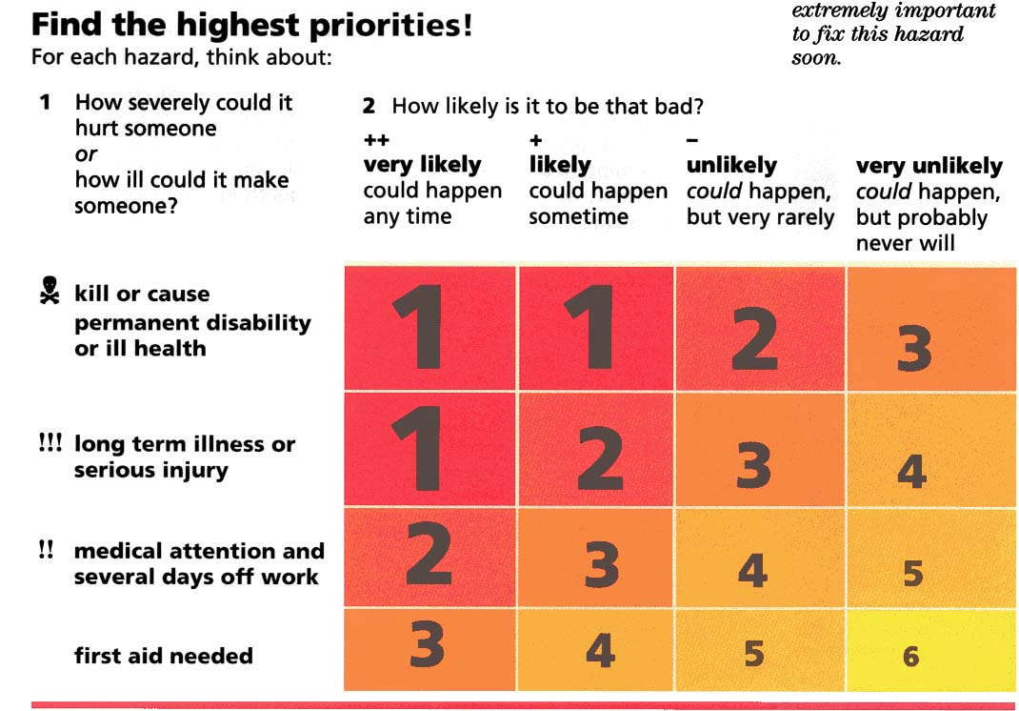
Risk Assessment Matrix (Hazpak)
1 = a hazardous event which is very likely and will probably cause death or permanent injury
6 = a hazardous event which is very unlikely and will only cause and injury requiring first aid

Slide 31

The Process
Inspect the training area – classroom / workplace
Observe & consult with employees performing the operation to decide the tasks that make up the complete operation and to assist in identifying any hazards associated with each task
Rate the hazard by using the Risk Assessment Matrix. Talk to employees about problems, the level of perceived risk, any possible control measures

Slide 32
Continues…
Once the information has been collected, assess the hazards and determine the possible control measures in line with the hierarchy of controls

Slide 33
Activity
In your groups, complete the ‘Learning environment risk assessment summary’ template and report back to the group.
Time allocated- 10 minutes

Slide 34
Review
Video

